Slide 1
Smoking in NZ Pacific adolescents
Samoan, Cook Island Māori, Tongan and Niuean
ASPIRE 2025 Research Group & ASH New Zealand

Slide 2
About the report
Available at www.ASPIRE2025.org.nz
Data is from the annual ASH Year 10 Snapshot survey
Report has 2 components
Updated trends by Pacific ethnicity, provided by ASH
Detailed findings about risk factors, conducted 2017 by ASPIRE researchers
Focus on: Samoan, Cook Island Māori, Tongan, Niuean adolescents (14-15 years old)
Notes:
Large sample size (about half the Year 10 students in NZ) enables analysis by specific Pacific ethnicity.

Slide 3
Methods
ASH Snapshot survey data. Participants = Year 10 students (14-15 years)
N=20,000 – 30,000 students per year.
Trend graphs:
ASH prioritisation: NZ Māori>Samoan>Cook Is Māori>Tongan>Niuean>NMNP.
NB: those who also identify both Māori & Pacific were NOT included in Pacific groups for trend graphs
Data were averaged across 2 years to decreased ‘noise’
Risk factor analysis
Those with dual Māori-Pacific identity ARE included in risk factor analysis
Prioritisation used: Niuean>Tongan> Cook Is Māori>Samoan>NMNP
Notes:
*Excluding Pasifika who also identify as Māori means that smoking estimates are likely to be UNDERESTIMATES.

Slide 4
Increasingly, 14-15 year olds are smokefree
Proportion (%) of Year 10 students who have NEVER smoked, 2004-2019
Notes:
Note: Niuean group is small so the margin of error is wide. The apparent fall in Niuean students who are smokefree is within the margin of error – so could be due to chance.

Slide 5
Regular smoking is lower than in 2004, but lack of recent progress is concerning
Regular smoking prevalence (%) in Year 10 students by ethnicity, 2004 - 2019
Notes:
Increase in regular smoking is statistically significant for Samoan and NMNP. (Other studies show a statistically significant increase for NZ Māori too)
Recent changes for other ethnicities are within the margin of error.

Slide 6
Daily smoking is lower than in 2004, but progress has stalled
Daily smoking prevalence (%) in Year 10 students by ethnicity, 2001-2019
Notes:
Recent changes in Pacific ethnicities are all within the margin of error

Slide 7
What explains ethnic differences?
Differences in adolescent smoking between Pacific ethnicities and NMNP were largely explained by differing exposure to key risk factors:
Socioeconomic status (school decile)
Parental smoking, especially maternal smoking
Exposure to second-hand smoke at home and in cars
Older sibling(s), best friend smokes
Even after adjusting for the factors above, adolescent smoking in Cook Island Māori remained higher than other ethnicities.

Slide 8
Prevalence of regular smoking and association with ethnicity, 2013–15
 | Unadjusted smoking prevalence | Unadjusted OR | 95% CI | Fully Adjusted OR* | 95% CI
NMNP (reference) | 3.8% | 1.0 |  | 1.0
Samoan | 5.9% | 1.6 | (1.3, 1.9) | 1.0 | (0.8, 1.2)
Tongan | 7.7% | 2.2 | (1.8, 2.7) | 1.1 | (0.8, 1.3)
Niuean | 10.2% | 3.0 | (2.2, 3.9) | 1.2 | (0.8, 1.6)
Cook Island Māori | 14.2% | 3.9 | (3.2, 4.6) | 1.7 | (1.4, 2.1)
*Adjusted for age, gender, school decile, parental smoking, sibling smoking, best friend smoking, past week exposure to smoking in the home and in vehicles
Notes:
Note: Unlike earlier trend graphs, these smoking prevalence estimates INCLUDE those who have dual Māori/Pacific identity.

Slide 9
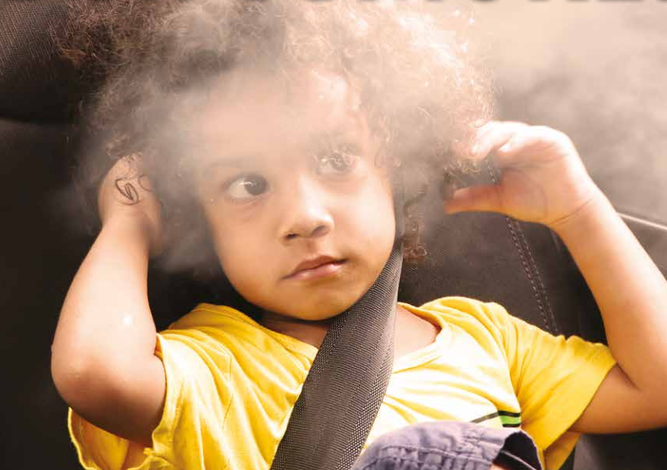
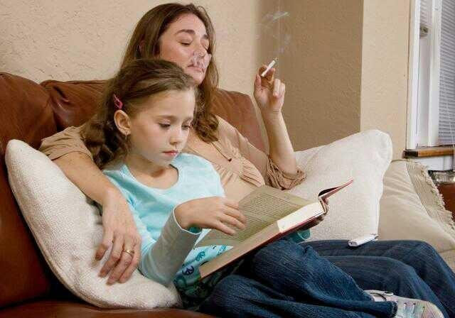
What are the most important preventable risk factors for adolescent smoking?
Smoking in the home and in cars
Photo credits: www.steemit.com & www.spc.int

Slide 10
Most important risk factors, 2012-2015
 | Proportion exposed to past week smoking in the home | Population attributable risk* | Proportion exposed to past week smoking in vehicles | Population attributable risk*
Samoan | 38% | 31% | 25% | 26%
Cook Island Māori | 53% | 46% | 35% | 15%
Tongan | 45% | 20% | 33% | 11%
Niuean | 43% | 32% | 31% | 39%
NMNP | 20% | 18% | 14% | 11%
*PAR is the proportion of regular smoking in the adolescent population attributable to this risk factor (assuming a causal relationship). It combines proportion of students exposed with strength of association between the risk factor and outcome.
Notes:
Pacific children are more likely to have parents who smoke, and are more likely to live in overcrowded housing (perhaps sharing with other families) – hence their exposure to SHS is much greater than for non-Māori/non-Pacific.
[Note: it’s NOT that Pacific smokers are more likely to smoke indoors than NMNP smokers]

Slide 11
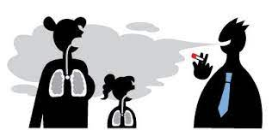
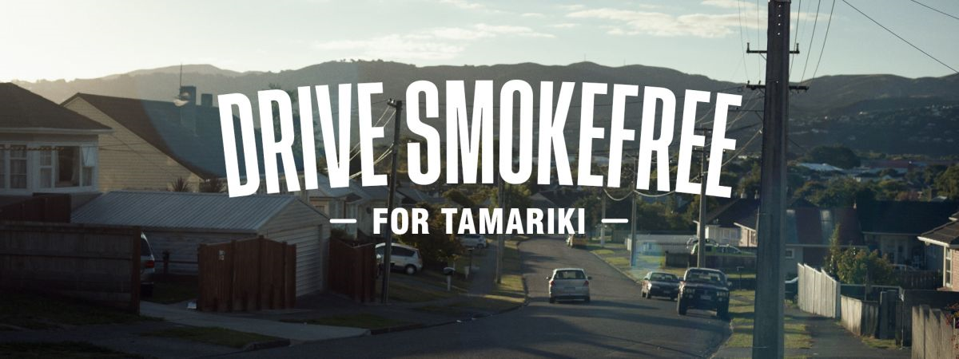
Smokefree homes & cars reduce risk of:
Kids taking up smoking themselves
Respiratory illnesses like bronchiolitis
Asthma
Ear infections, glue ear
SUDI/cot death
Meningitis
And for adults in the home, risk of:
Heart disease
Stroke
Lung cancer

Slide 12
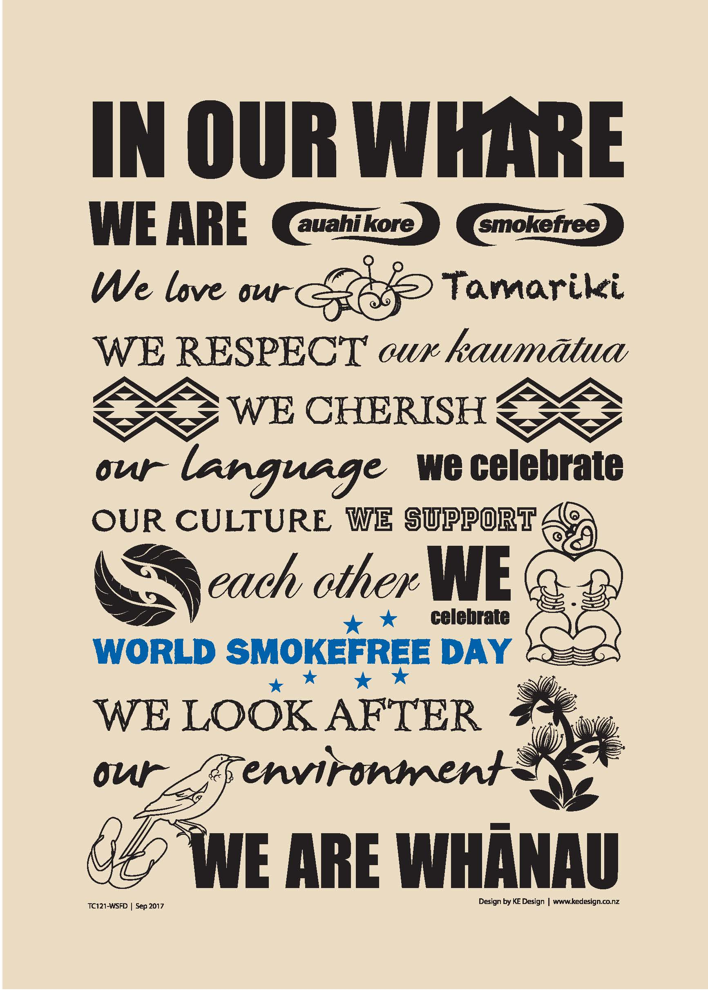
Pacific community action
The Covid response shows how effectively Pacific communities mobilise, given opportunity and resources
What would ‘By Pacific, For Pacific’ Smokefree2025 community action look like?
‘By Māori, for Māori’ Auahi Kore community action provides an example…

Slide 13
Conclusions & Recommendations (1)
New Zealand tobacco control research and practice needs to reflect the important differences between Pacific ethnicities
Lack of recent progress is concerning. A renewed focus on smoking prevention is urgently needed.
Initiatives to promote smokefree homes and cars should be a prevention priority.
Greater investment is needed in ‘By Pacific, for Pacific’ community action to achieve Pacific Smokefree aspirations
The need is greatest in Cook Island Māori communities, who may require greater support to achieve equity of outcomes.

Slide 14
Conclusions & Recommendations (2)
6. The impact of the new Smokefree cars law from Nov 2021 on Pacific peoples should be monitored (including any negative impact of over-policing)
7. Ongoing monitoring of youth smoking is needed, in 14-15 year olds, older adolescents and young adults. Surveys need to include boosted Pacific samples.
8. Upstream factors are important. Need to improve living and working conditions and remove structural barriers that disadvantage Pacific peoples. This will support the Smokefree2025 goal and the wellbeing aspirations of Pacific peoples.

Slide 15
Full report available now!
www.ASPIRE2025.org.nz

