Slide 1



The impact of an increase in excise tax on the retail price of tobacco in New Zealand
Louise Marsh, Claire Cameron, Robin Quigg, Janet Hoek,
Crile Doscher, Rob McGee and Trudy Sullivan
Cancer Society Social & Behavioural Research Unit (SBRU)
Te Hunga Rangahau Ārai Mate Pukupuku
25 years of social & behavioural research in cancer control

Slide 2
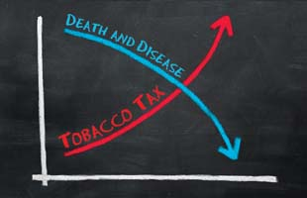
Effectiveness of tax increases
Single most effective measure to reduce health burdens

Slide 3

Effectiveness of tax increases
Demand elasticity
  Price increase of 10% would reduce consumption by 4%
  Young people are more price sensitive
Industry tactics
  Over and under shifting taxes

Slide 4

Aims of the research
  Whether, on average, tobacco retailers charge British American Tobacco’s (BAT) Recommended Retail Price (RRP) for different brand segments
  Whether BAT applied the annual 10% tobacco excise tax increase differentially to budget, mainstream, premium and RYO brands over the period 2010 to 2014.

Slide 5
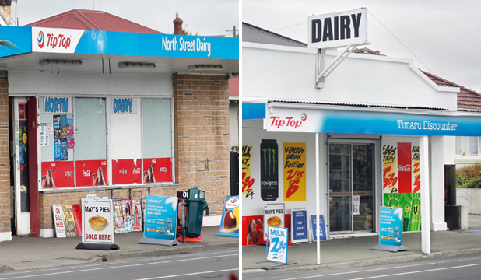
What did we do?
Data was collected from a sample of retailers from 10 DHB’s
Focused on 4 types of retailers:
  Convenience stores
  Supermarkets
  Service stations
  Liquor stores
Proportional random sample
Final sample 711 retailers
Price data was collected:
  Stage 1: Nov/Dec 2013
  Stage 2: Jan/Feb 2014

Slide 6

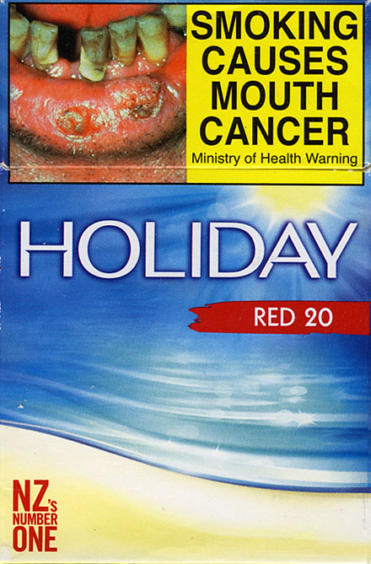
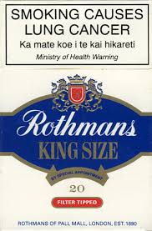
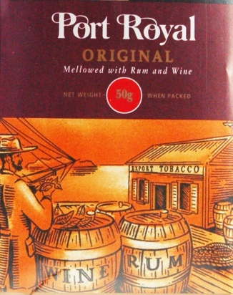
BAT brands selected
Budget
461 retailers
Mainstream
471 retailers
Premium
448 retailers
RYO
464 retailers

Slide 7

Change in retail price after 10% tobacco excise tax increase Jan 1st 2014
Budget
Mainstream
Premium
RYO
+3%
+11%
+8%
+11%

Slide 8
Change in RRP from 2010 to 2014
 | 2011 | 2012 | 2013 | 2014
Budget (GST excl)
RRP | $10.43 | $12.00 | $13.57 | $13.91
Expected RRP | $12.43 | $13.68 | $14.68 | $15.79
Difference | $(1.92) | $(1.68) | $(1.11) | $(1.87)
Premium (GST excl)
RRP | $15.57 | $17.39 | $19.48 | $21.65
Expected RRP | $15.13 | $16.77 | $18.02 | $19.43
Difference | $0.44 | $0.62 | $1.46 | $2.22

Slide 9
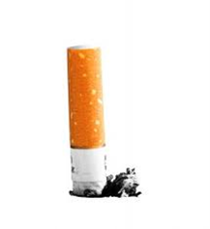
Implications: Quitting
Calls to Quitline increased after 2010 excise tax increase
Callers more likely to cite cost as reason for quitting
Impact of excise tax increases on quitting may not be maintained
Acclimation:
  Anticipate tax increases
  Switch to cheaper alternative

Slide 10
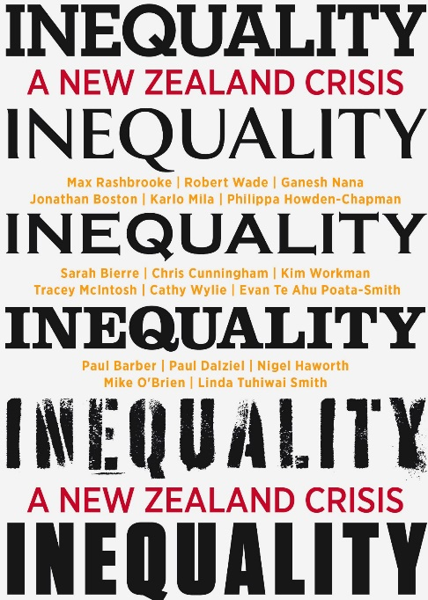
Implications: Regressiveness of tax
Excise tax may inequitably burden smokers from low SES groups – health inequalities
Māori and Pacific Island smokers more responsive to tax increases
Hypothecation of taxes
Stimulate greater cessation

Slide 11
What next?
Excise tax modification:
  Larger increases of at least 20%
  A large, one-off, surprise tax increase of 40%
Additional policy measures
  Flat rate minimum price laws
  Mark up minimum price laws
Part of a comprehensive tobacco control programme

Slide 12

Conclusion
Current tax structure allows tobacco companies to shift tax increases between price partitions
Policy makers need to consider modifications
Policies to limit the current responses
Excise tax is an important part of achieving the endgame

Slide 13

Thank you
The researchers wish to thank the Smokefree Enforcement Officers and Cancer Society staff who collected data for this study.
Contact details:
Louise Marsh
Cancer Society Social and Behavioural Research Unit University of Otago
Louise.marsh@otago.ac.nz

