Slide 1
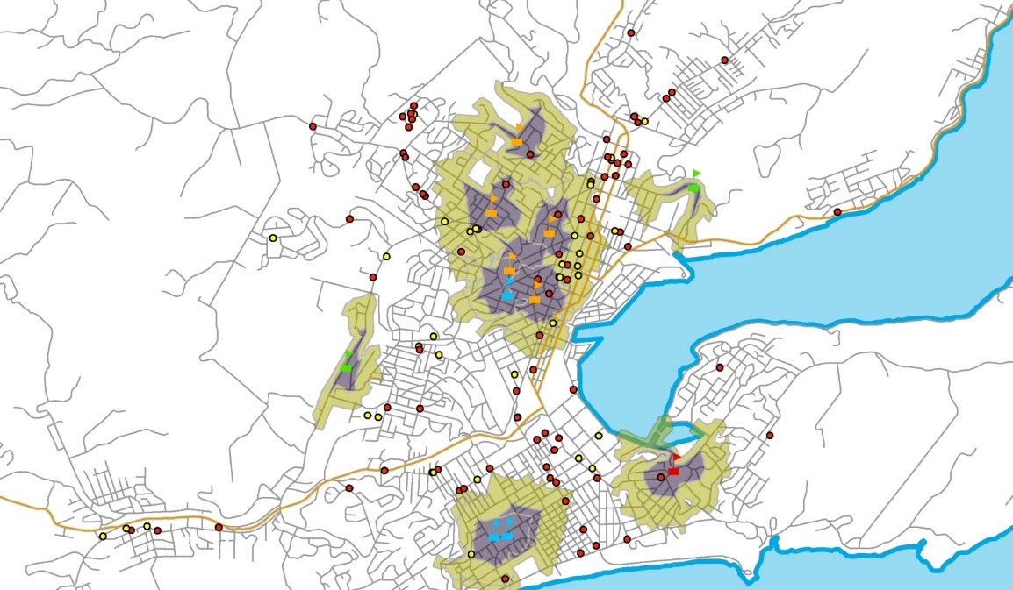


Tobacco retail outlet density and risk of youth smoking in New Zealand
Louise Marsh, Ali Ajmal, Rob McGee, Lindsay Robertson, Claire Cameron, Crile Doscher
Cancer Society Social & Behavioural Research Unit (SBRU)
Te Hunga Rangahau Ārai Mate Pukupuku
25 years of social & behavioural research in cancer control

Slide 2
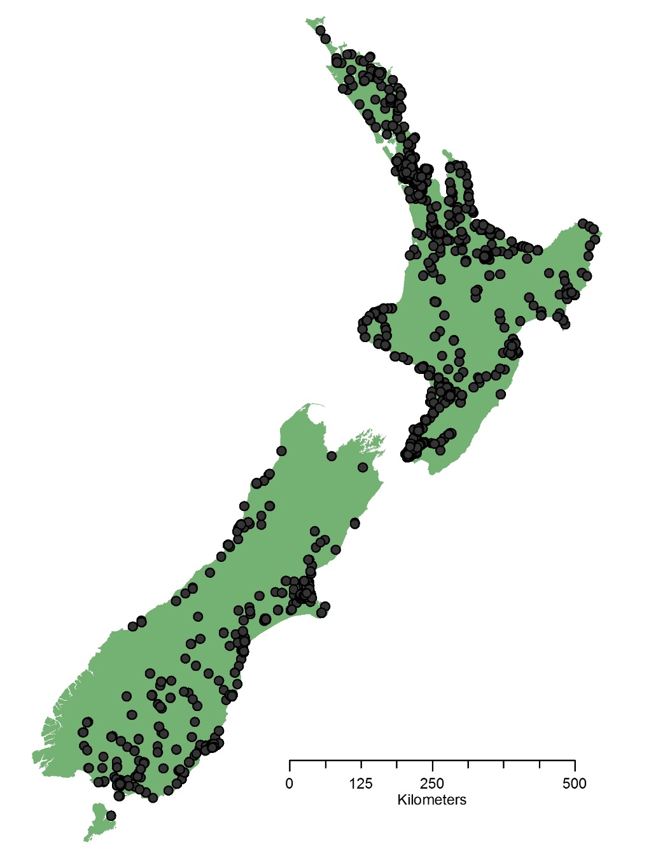
Tobacco retail outlets in New Zealand

Slide 3
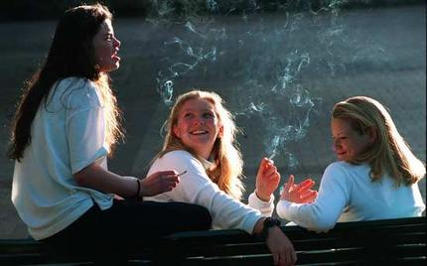
Background
Relationship between density of tobacco outlets around a school and risk of smoking among students
  Density higher with larger proportion of young people
  Experimental, current smoking, and susceptibility to smoking
  Purchasing tobacco
  Normalisation of smoking

Slide 4

Aim of the study
This study investigates whether the density of tobacco outlets around secondary schools in New Zealand (500m and 1000m) is associated with current smoking, susceptibility to smoking, and purchasing of tobacco.

Slide 5

Density of tobacco retail outlets
500 and 1000m polygons

Slide 6
What did we find? Current smoking
Retailer Density | 500m of a school Adjusted odds ratio (95% CI) | 1000m of a school Adjusted odds ratio (95% CI)
0 Density | Reference | Reference
Low density | 0.89 (0.8, 0.99) | 0.79 (0.65, 0.96)
High density | 0.75 (0.65, 0.87) | 0.8 (0.67, 0.96)

Slide 7
What did we find? Susceptibility to smoking
Retailer Density | 500m of a school Adjusted odds ratio (95% CI) | 1000m of a school Adjusted odds ratio (95% CI)
0 Density | Reference | Reference
Low density | 0.98 (0.89, 1.08) | 1.03 (0.95, 1.11)
High density | 1.09 (1.03, 1.14) | 1.07 (1.01, 1.16)

Slide 8
What did we find? Purchasing tobacco
Retailer Density | 500m of a school Adjusted odds ratio (95% CI) | 1000m of a school Adjusted odds ratio (95% CI)
0 Density | Reference | Reference
Low density | 1.06 (0.75, 1.49) | 1.16 (0.8, 1.68)
High density | 1.18 (0.83, 1.67) | 1.52 (1.07, 2017)

Slide 9



Strategies used internationally
Cayuga County, New York
Santa Clara County, California
Huntingdon Park, California
Lynwood Park, California

Slide 10

Implications: Retail endgame strategies
Number of tobacco retail outlets represents a major form of promotion
Further regulation of the retail environment
  Restricting the density or distance of tobacco outlets around schools
Public support is high, even among smokers
Policy measures

Slide 11


Contact details:
Louise Marsh
Cancer Society Social and Behavioural Research Unit, University of Otago
Louise.marsh@otago.ac.nz

