Slide 1



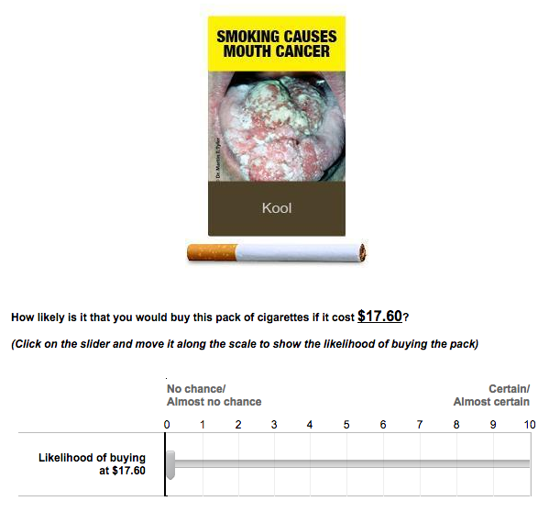
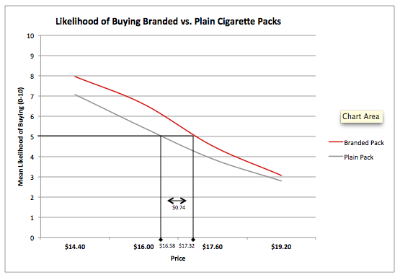

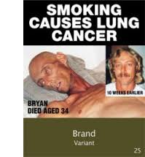

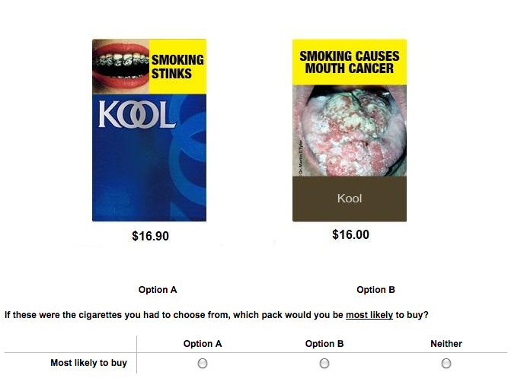
Impact of standardised packaging relative to a tobacco price increase
P Gendall¹ | J Hoek ¹ | C Eckert³ | J Louviere ² | T Farley ¹ | R Edwards ¹ | N Wilson ¹ ¹ University of Otago (Dunedin and Wellington) , ²University of South Australia, ³University of Technology Sydney
Overview
STUDY ONE: Willingness to Pay
Discussion and Conclusions
Tobacco companies question whether standardised (or ‘plain’) packaging will change smokers’ behaviour.
We estimated how standardised packaging compared to a proven tobacco control intervention, price increases through excise taxes, to develop a quantitative measure of this policy’s likely effect.¹
We used a purchase probability scale, similar to the 11-point Juster scale, to test demand at four different price points:
$14.40
$16.00
$17.60
$19.20
Industry Claims Unsupported
Tobacco companies have opposed plain packaging by arguing that policy makers have no evidence this measure will change behaviour.
  Estimating the effect of plain packaging relative to a known measure – price increases – addresses this argument.
Irrespective of the task, consumers valued tobacco branding and were prepared to pay a premium for this feature.
Responsiveness to Branding Varies Considerably
The trade-offs smokers made varied across preference segments
  Lighter smokers and those who had not made a recent quit attempt were willing to pay more to retain brand elements.
Heavier smokers were less responsive, but nonetheless willing to pay $.73 to obtain a branded pack with their preferred warning image.
Preference for the warning image also varied, highlighting the need for more diverse images to reach varied smoker sub-groups
Limitations
We tested choice patterns rather than actual behaviour. Our sample under-represented Māori and Pacific participants, though this is likely to have under-estimated the effects reported.
Implications
As the premium smokers are prepared to pay for a branded pack diminishes as the price increases, excise tax increases should accompany plain packaging.
Background Research
Brand Value
Consumers buy branded products for their symbolic as well as functional properties.²
Pricing
Experimental Auctions
Experimental auctions have immediate monetary consequences and higher external validity than stated intentions.
Tobacco branding promotes smoking as a desirable behaviour and deflects attention from health warnings.³
Addiction means demand for tobacco is relatively inelastic and more heavily addicted smokers may be less responsive to plain packaging.⁴
Demand for plain packages with large pictorial warnings was lower than for other packs, particularly among smokers with lower education levels.^{4,5}
Young and lower socio-economic smokers have greater price sensitivity than older smokers and may be more willing to trade brand off against price.
Branding gives homogenous products distinctive properties.
Respondents had a higher likelihood of purchasing the branded pack than the plain pack at all four price points tested; these differences were significant at the lower two price points.
Willingness to pay more for a branded pack relative to the plain pack at the 50% purchase likelihood was 74 cents.
STUDY TWO: Choice Experiment
The choice experiment:
Tested different brand, price and warning combinations, and
Estimated the trade-offs smokers made between these attributes.
+
=
Research Question
What value do smokers attribute to branded tobacco packages relative to standardised packages?
References
The best model had three preference classes and one scale class (indicating consistent choice patterns).
Each attribute and a brand-warning theme interaction were significant.
The average willingness to pay for a branded pack was 79 cents, though WTP varied by preference class.
1 Gendall P, Eckert C, Hoek J, Farley T, Louviere J, Wilson N, et al. Estimating the ‘consumer surplus’ for branded versus standardised tobacco packaging. Tob Cont. 2015. doi:10.1136/tobaccocontrol-2015-052488
2 Hoek J, Gendall P, Gifford H, Pirikahu G, McCool J, Pene G, et al. Tobacco branding, plain packaging, pictorial warnings, and symbolic consumption. Qual Hlth Res. 2012; 22: 630-39.
3 Carter S. The Australian cigarette brand as product, person, and symbol. Tob Cont. 2003; 12: 79-86.
4 Rousu MC, Thrasher JF. Demand reduction from plain and pictorial cigarette warning labels: evidence from experimental auctions. Appl Ec Persp & Pol. 2013; 35: 171-84.
5 Thrasher J, Rousu M, Hammond D, Navarro A, Corrigan JR. Estimating the impact of pictorial health warnings and “plain” cigarette packaging: evidence from experimental auctions among adult smokers in the United States. Hlth Pol. 2011; 102: 41-48.
Methodology
Sample: 311 participants obtained from an internet panel provider. Quotas ensured adequate processing samples and the data were weighted to reflect the New Zealand smoking population.
Design: A two phase study comprising:
A choice experiment that estimated attribute trade-offs.
A probability experiment that estimated willingness to pay for different pack options at varied price levels.
Attribute | ‘Consumer Surplus’ Estimates (cents, NZ currency)
 | Whole Sample | Seg 1 | Seg 2 | Seg 3
 | Estimate (95% CI) | Estimate (95% CI) | Estimate (95% CI) | Estimate (95% CI)
Branded cf. plain | 79 (74-84) | 174 (145-203) | 23 (20-27) | 143 (96-191)
Social warning cf. health warning | 28 (24-32) | -93 (-120-(-64)) | 50 (44-57) | 171 (113-229)
Branded + social cf. plain + health | 108 (83-132) | 82 (38-126) | 74 (54-93) | 314 (125-504)
Contact and COI
The authors have no conflicts of interest to declare.
For more information, contact Professor Phil Gendall: philip.gendall@otago.ac.nz
www.aspire2025.org.nz

